Slide 1
Economic Impact of COVID-19 on the Tourism Industry
Submitted by:
Rahul | Shaurya Malhotra | Amit Kumar Yadav
Subject: Office Automation
Teacher: Jyoti Dhiman
Date: 3 November 2025

Slide 2
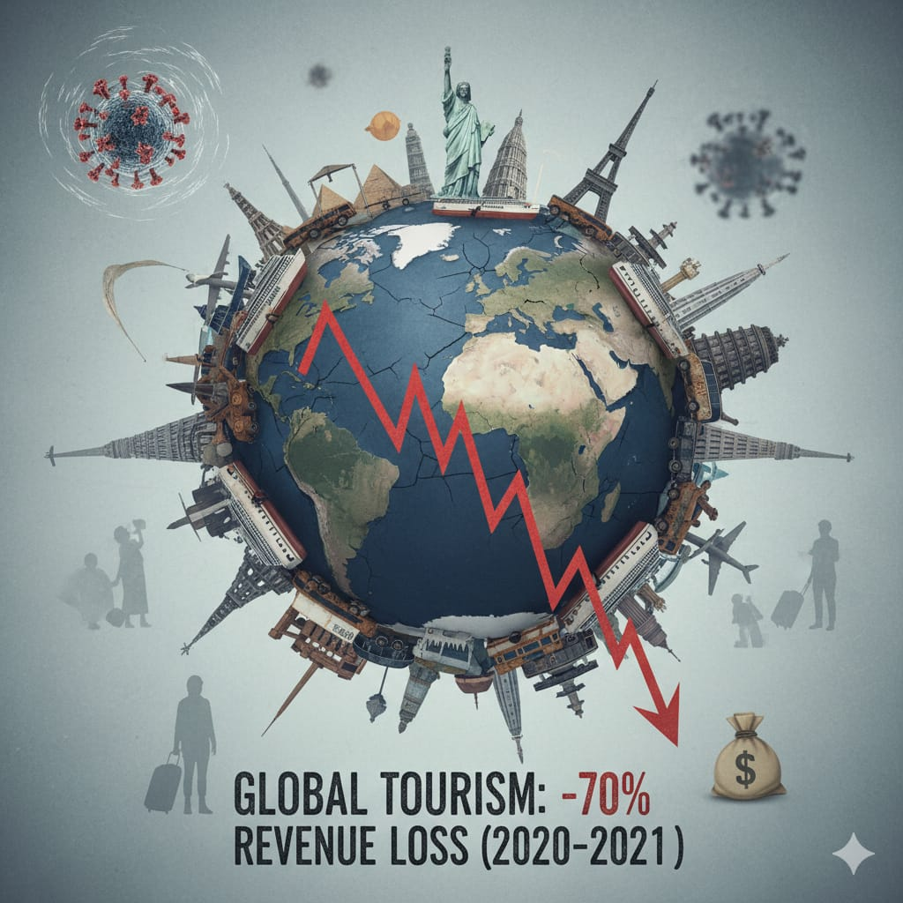
Introduction
The COVID-19 pandemic severely disrupted the global economy. The tourism industry was among the hardest hit due to travel bans, lockdowns, and a decline in international travel. This study explores the pandemic's impact on tourism businesses, employment, and revenue.

Slide 3

Objective :
To analyze how COVID-19 affected the tourism industry in terms of:
Business closures
Employment decline
Revenue loss
Recovery trends after 2021

Slide 4
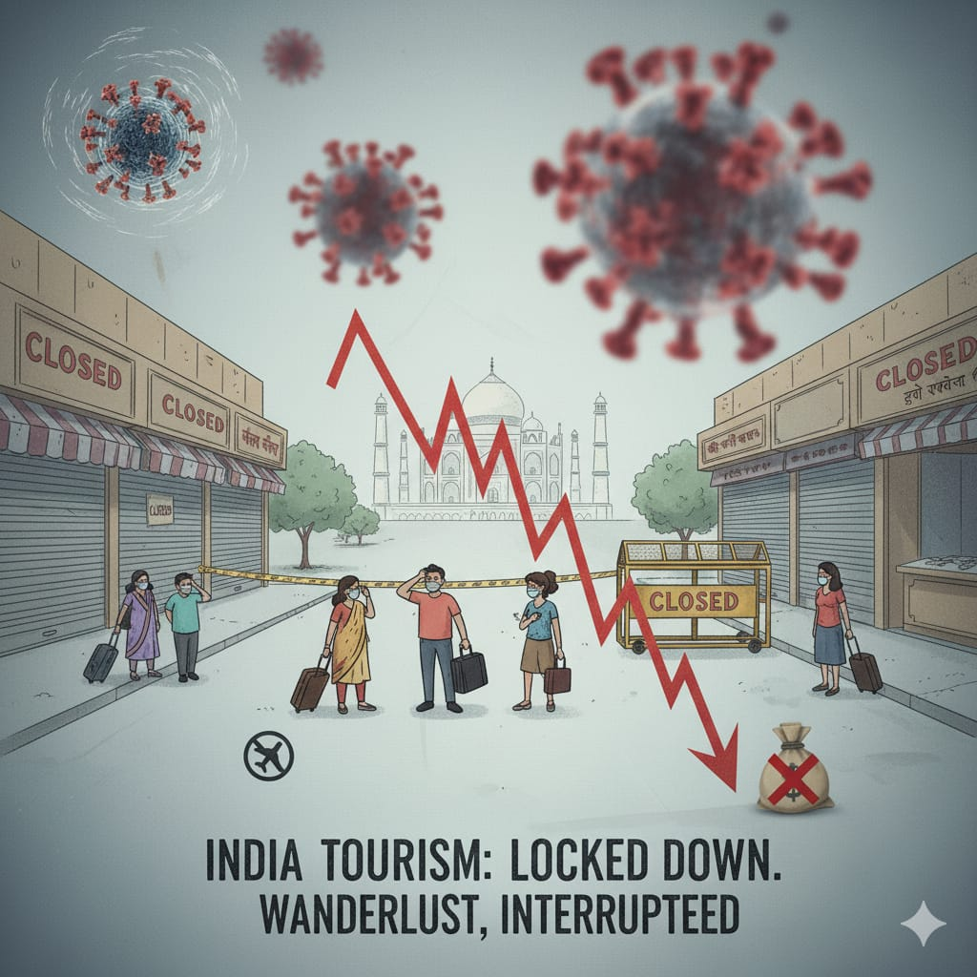
Data Collection and Process
Data was collected from tourism reports, news, and online databases (2019–2022). Microsoft Excel was used to organize and analyze trends in:
• Tourism revenue
• Employment rates
• Business closures

Slide 5
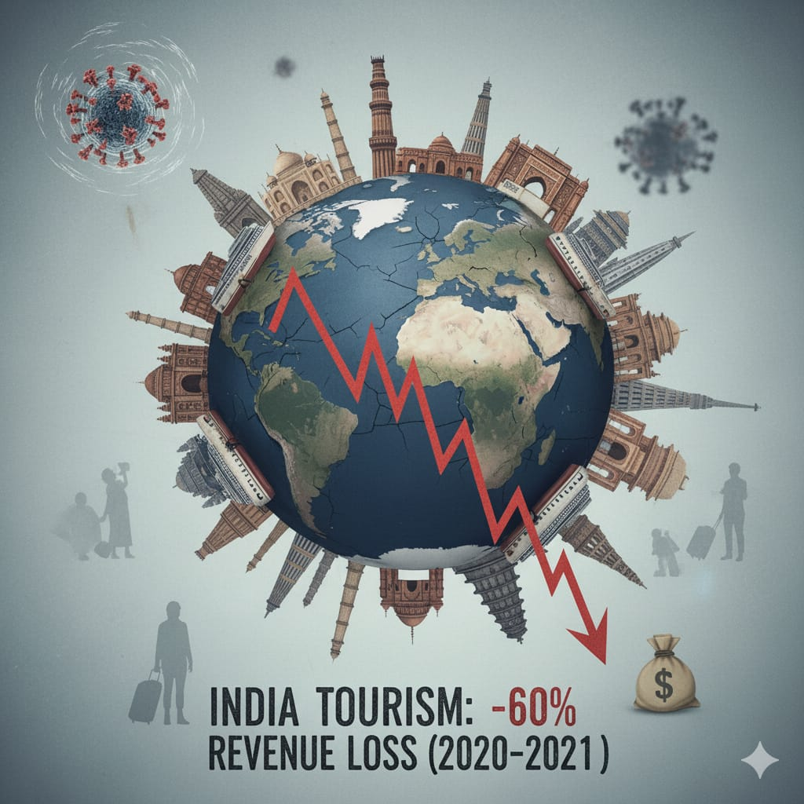
Findings and Analysis
• Tourism employment fell by nearly 45% in 2020.
• Revenue dropped by 60–70% compared to 2019.
• Thousands of small tourism businesses closed.
• 2021 saw gradual recovery due to vaccination and domestic tourism.
• By 2022, the sector began showing growth again.

Slide 6
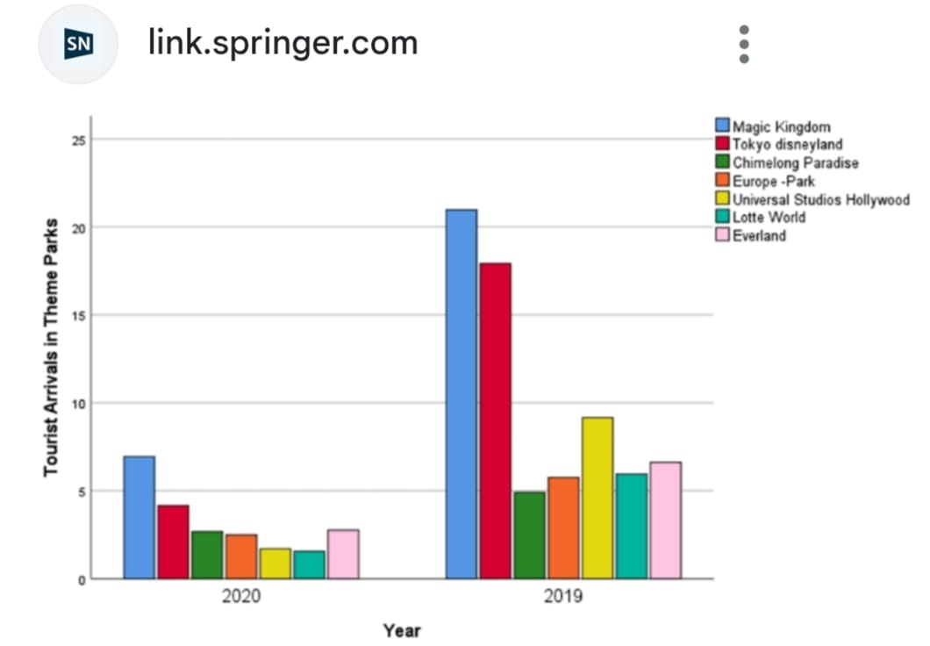

Slide 7
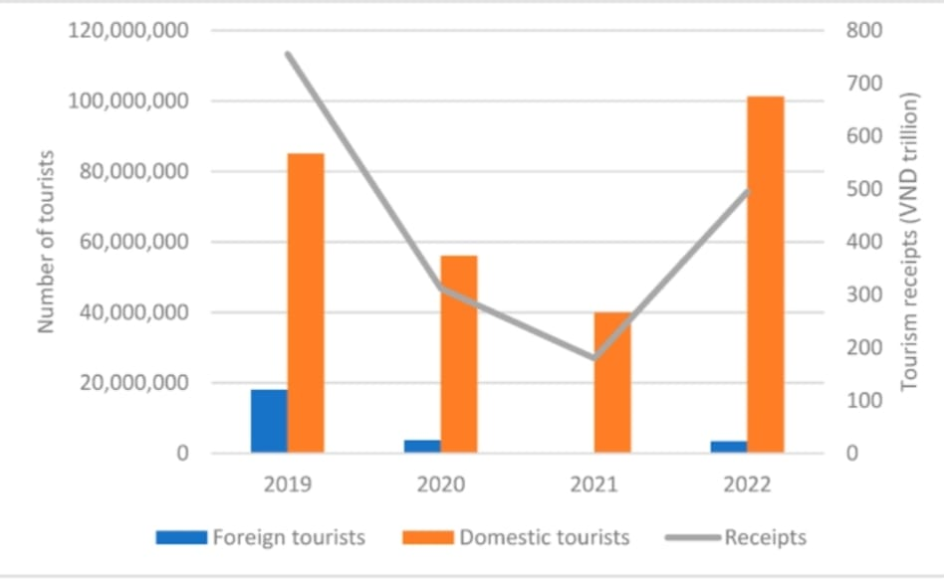

Slide 8
Conclusion
COVID-19 caused massive damage to the tourism industry, but recovery has begun through government support and innovation.
Future growth depends on:
• Sustainable tourism
• Health stability
• Digital transformation and adaptation.

Slide 9
References
1. Ministry of Tourism, Government of India Report (2021)
2. UNWTO – COVID-19 Tourism Recovery Tracker
3. Statista – Tourism Sector Impact
4. The Economic Times – Tourism Recovery Reports (2021–2022)

